Slide 1
Research Project Management System
Preview Presentation

Slide 2
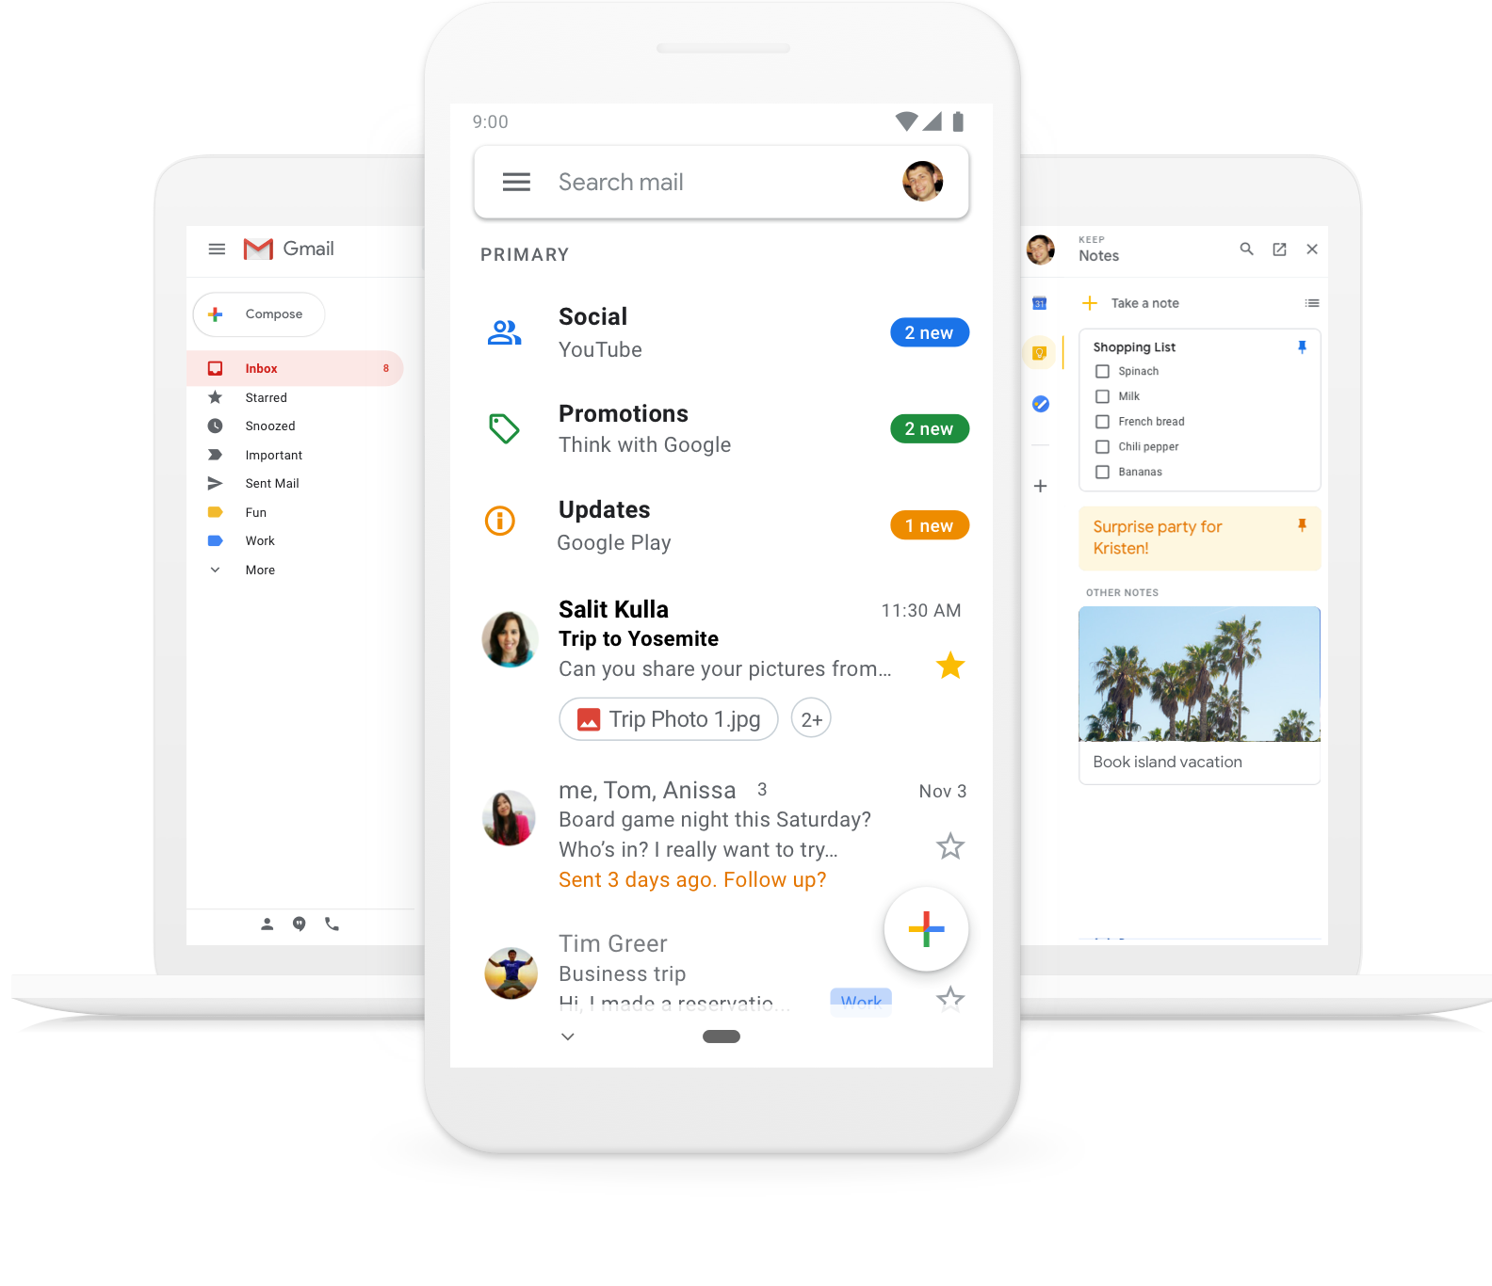
App’s Logo
Sign in
Create an account
Here we will add some images from our app like:
Get more done with your Research Projects
Now more efficient, smarter and easier way—helping you save time and do more with your Research Projects .
Create an account

Slide 3
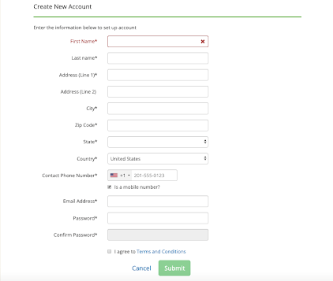
App’s Logo
Already have an account?
Sign in
Create an account

Slide 4
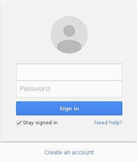
App’s Logo
Don’t have an account?
Create an account
Sign in
Email address
Create new account

Slide 5











App’s Logo
Faculty
Logout
My Tasks
Create
Assign
Fix
Share
End
Interact
Remind
Progress
Projects
Inventory
Tasks
Calendar Entries
Project 1
Project 2
Project 3
Project 4
Project 5

Slide 6


App’s Logo
Faculty
Logout
My Tasks
Create
Assign
Fix
Share
End
Interact
Remind
Progress
Tasks
Projects
Inventory
Resources
Calendar Entries
B.Tech Project
M.Tech Project
PhD Project
Internship
Sponsored Project
Misc

Slide 7

App’s Logo
Faculty
Logout
My Tasks
Create
Assign
Fix
Share
End
Interact
Remind
Progress
Projects
Inventory
Tasks
Equipment
Consumables
Devices
Faculty
Lab-incharge
Mentor
Team member

Slide 8
Model 1
(A pop-up message appears for Team Member)

Slide 9
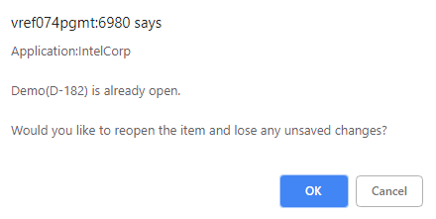
App’s Logo
Team Member
Logout
My Tasks
Create
Assign
Fix
Share
End
Interact
Remind
Progress
Pop-up message
Server says:
Tasks
Projects
Inventory
Resources
Calendar Entries
Access not granted.
You do not have permission to perform this specific task

Slide 10
Model 2
(Only user specific tabs are displayed)

Slide 11
App’s Logo
Team Member
Logout
My Tasks
Create
Assign
Fix
Share
End
Interact
Remind
Progress
Tasks
Calendar Entries
Resources
Deadlines
Meetings
Reminders

Slide 12
Progress Tab

Slide 13


App’s Logo
Team Member
Logout
My Tasks
Create
Assign
Fix
Share
End
Interact
Remind
Progress
Project 1
Project 2
Project 3
Project 4
Project 5
Project 6

Slide 14
App’s Logo
Team Member
Logout
Project 5
My Tasks
Create
Assign
Fix
Share
End
Interact
Remind
Progress
Sub-Tasks Completed
Sub-Task | Submission Date | Status
PowerPoint presentation 1 | 24/02/2020 | Completed
Report Making 4 | 28/02/2020 | Completed
Sub-Tasks Pending
Sub-Task | Submission Date | Status
PowerPoint presentation 2 | 19/04/2020 | Not Completed
Report Making 5 | 30/04/2020 | Not Completed

Slide 15
Model 1 Discussion

Slide 16
USER (FACULTY)
SERVER
OUTPUT
PERFORMS ACTION TO CREATE NEW PROJECT
ANALYSES USER TYPE AND ACTION PERFORMED
ALLOWED TO CREATE NEW PROJECT
USER (MENTOR)
SERVER
OUTPUT
PERFORMS ACTION TO CREATE NEW PROJECT
ANALYSES USER TYPE AND ACTION PERFORMED
A POP-UP SAYING THAT PERMISSION NOT GRANTED
USER (TEAM MEMBER)
OUTPUT
PERFORMS ACTION TO CREATE NEW PROJECT
ANALYSES USER TYPE AND ACTION PERFORMED
A POP-UP SAYING THAT PERMISSION NOT GRANTED
SERVER

Slide 17
For example we have client A and client B. In server we can assign like client A have admin permission but client B don’t.
Lets say there is "comment" button. Both client A and client B can send request to server for comment but before updating, database server checks and if request is from client A it update database that means comment has been posted but when client B request it return error message that you are not permitted to do that.
To distinguish between client A and client B, we assign different credentials to both of them and send these credentials or token generated by these credentials to server each time some request is made.

Slide 18
Model 2 Discussion

Slide 19
We should use Dynamic Page Generation by keeping the elements dynamic.
Means, when someone requests a webpage, then we can generate page dynamically and send that page to the user which depends on user type (Faculty, Lab- incharge, Mentor, Team Member).
For example if site’s request came from FACULTY then content should be generated accordingly and if TEAM MEMBER requests then content should be generated according to his permissions granted.

